Slide 1
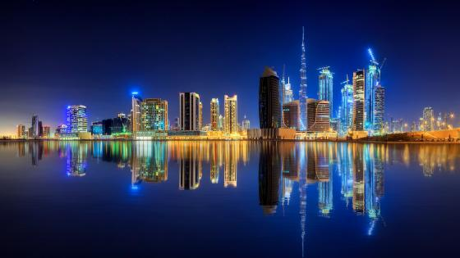



Slide 2
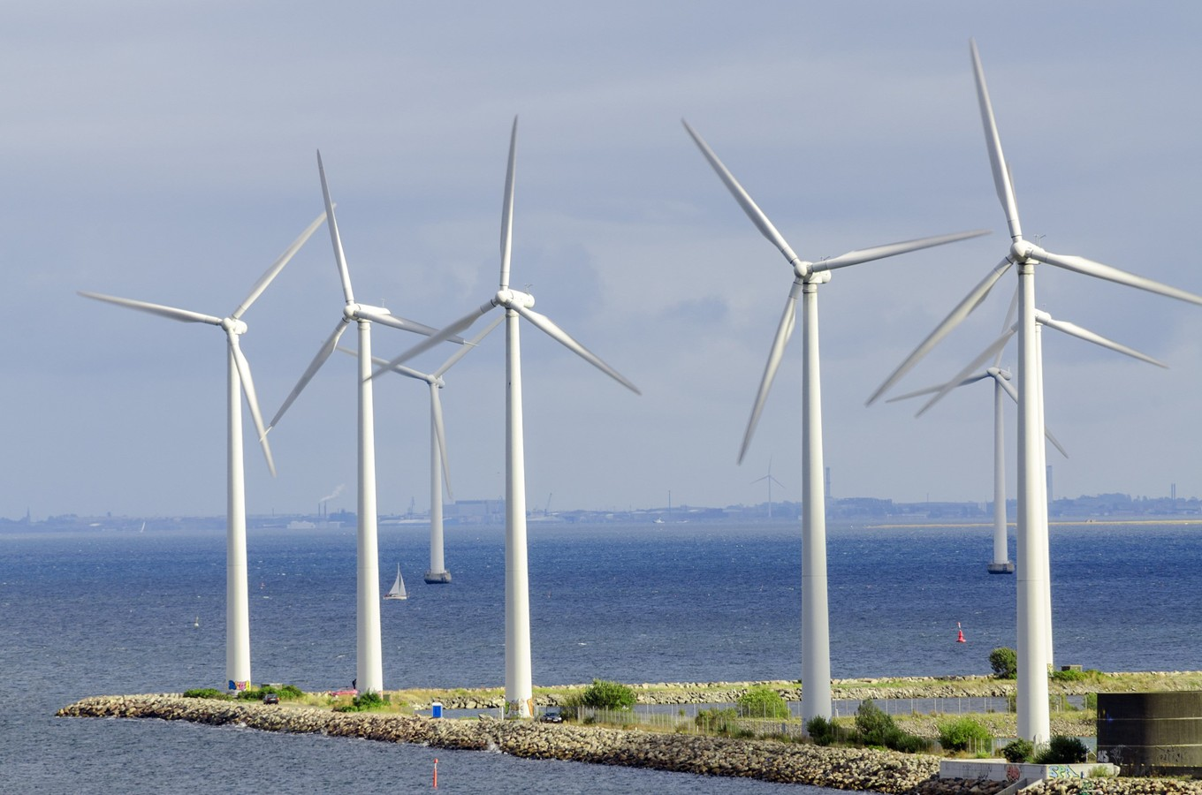
PART 04
Introduction to Wind Energy
Wind energy is a renewable and eco-friendly source of power.
It uses wind turbines to convert moving air into electricity,
helping reduce pollution and support a clean, sustainable future.
PART 03
PART 01
PART 02

Slide 3
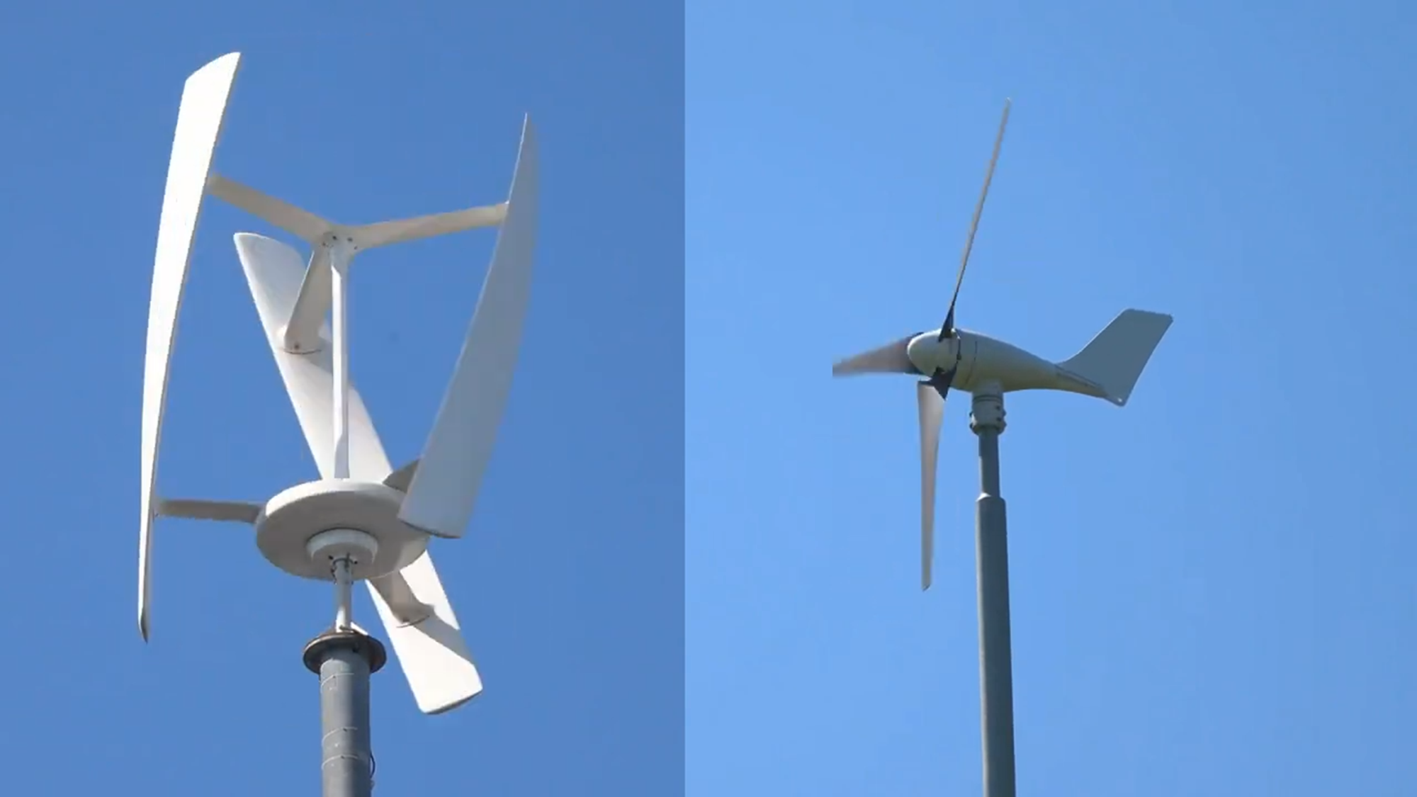
PART 04
HAWT VS. VAWT
HAWT: Blades rotate horizontally, used for large power generation.
VAWT: Blades rotate vertically, work well in all wind directions and urban areas.
PART 03
PART 01
PART 02

Slide 4
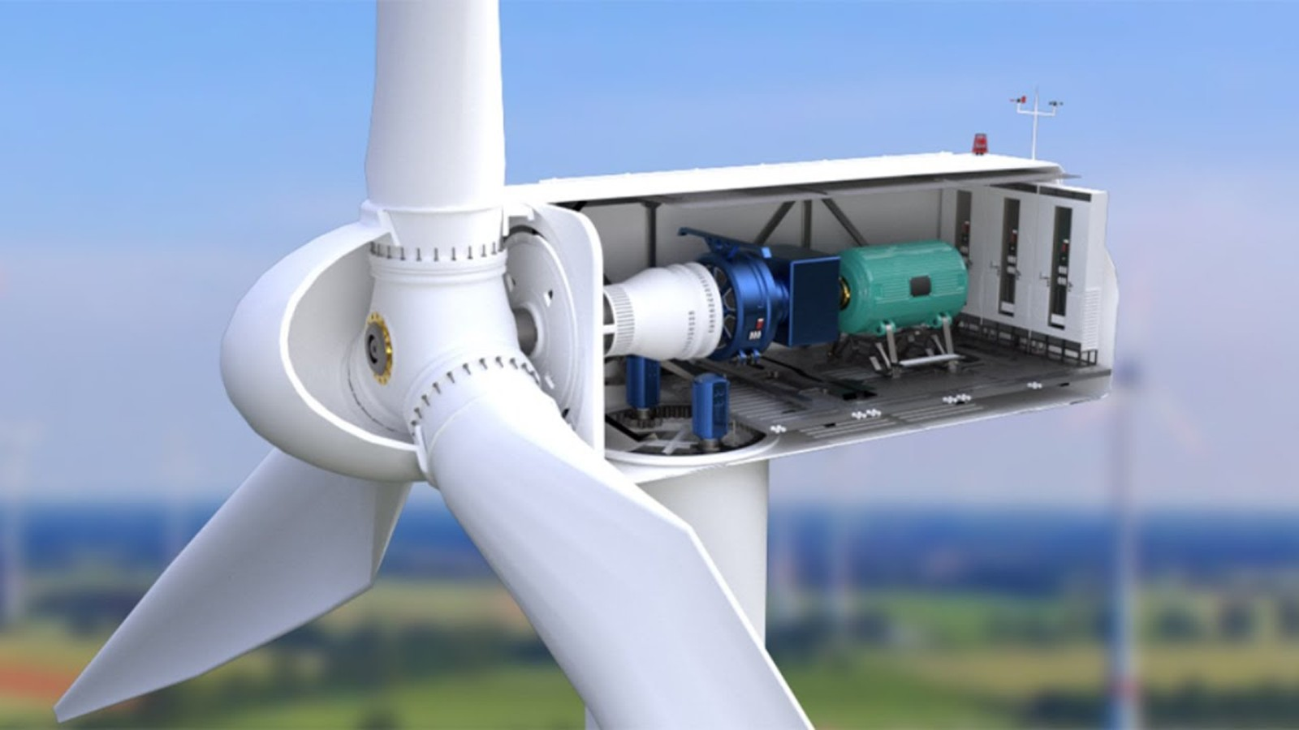
PART 04
Internal Parts Of a Wind Motor:
A wind motor has key parts that help generate electricity:
Blades capture wind,
The Shaft transfers motion
And the generator converts it into electric power.
PART 03
PART 01
PART 02

Slide 5
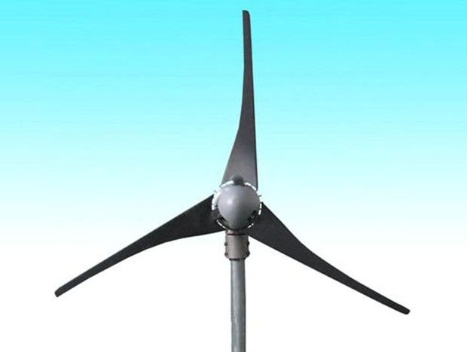
PART 04
Wind Turbine Blades:
Blades capture the kinetic energy of wind and turn it into rotational motion.
They are made of lightweight and strong materials to spin easily and produce more power.
PART 03
PART 01
PART 02

Slide 6
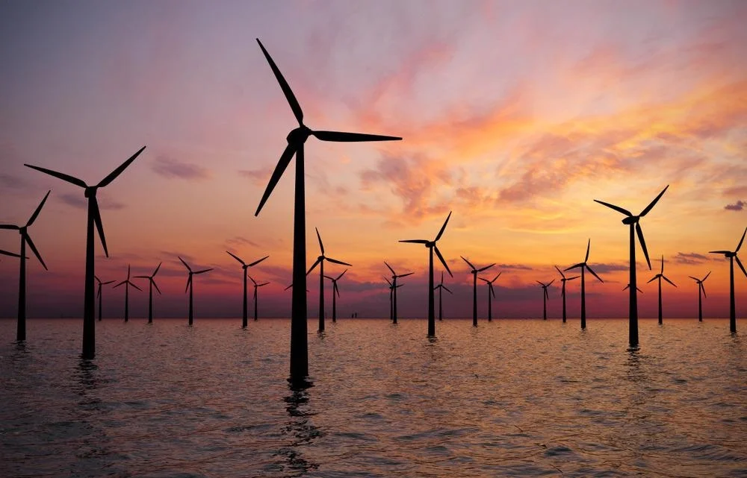
Conclusion:
Windmills are built in open and windy areas like hills and coastal regions to produce clean, renewable electricity.
They help reduce pollution and carbon emissions, making them eco-friendly and cost-effective.
However, they can cause noise, need large space and depend on wind availability.
Overall, windmills are an important step toward a green and sustainable future.

Slide 7
Represented by:
ABDUL MATEEN SETHI

